Slide 1
What we are working on...
To name mental, emotional, material habits associated with privilege, which support ongoing oppression and may be invisible.
To identify how privilege has affected the history and current understanding of “good” environmental behavior and beliefs.
To recognize the importance of reflecting on one’s own positionality whenever we communicate. Positionality is important to consider in our beliefs, our stories, our arguments, etc.

Slide 2
Readings We Completed
Last Time:
Clare, Eli. “Clearcut.” in Exile and Pride: Disability, Queerness, and Liberation. Duke UP, 2015.
For Today:
Harper, Breeze. “Vegans of Color: Racialized Embodiment, and Problematics of the Exotic.” In Cultivating Food Justice: Race, Class, and Sustainability, edited by Alison Hope Alkon and Julian Agyeman. MIT Press, 2011.

Slide 3
Ways-In Writing Exercise
1. Start with the activist essay you brought to class today.
2. Take up a different lens or perspective than you had at first.
3. Ask 10 questions about what you’ve written so far.
4. Imagine posing those questions to someone else, for discussion. Write about the conversation that might take place.
5. How does your piece relate to what you have and have not experienced in your life, in your background? What about your topic might be beyond your understanding?

Slide 4
Eli Clare
Danger of a Single Story about Disability:
“The dominant story about disability should be about ableism, not the inspirational supercrip crap or the believe-it-or-not disability story” (3).
“I use the word disabled as an adjective to name what this ableist world does to us...” (83).
“Shouldn’t I call non-disabled people enabled?”(82).
“We Need A Great Flock of Stories” (About the context for the poem)

Slide 5
Eli Clare
Danger of a Single Story about Logging:
“Rather than believing that loggers are murderers...pure and simple, maybe you place loggers...as the quintessential exploited worker in a capitalist economy. [...] Make no mistake: there is nothing romantic about logging. It is dangerous work, fraught with hazards that can tear bodies apart” (58).
“Who is going to save the logger? If we as a county are finally deciding...to save the spotted owl and fragments of its habitat, then we as a people need to be accountable to the folks who will be unemployed, possibly homeless and hungry, because of that decision. To turn away from this is to act as if loggers and logging communities are more complicit with environmental destruction than the rest of us” (61).

Slide 6
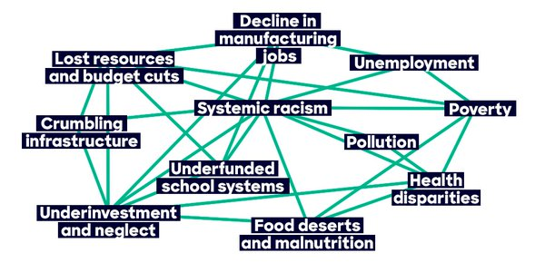
Oppressive forces are interconnected

Slide 7
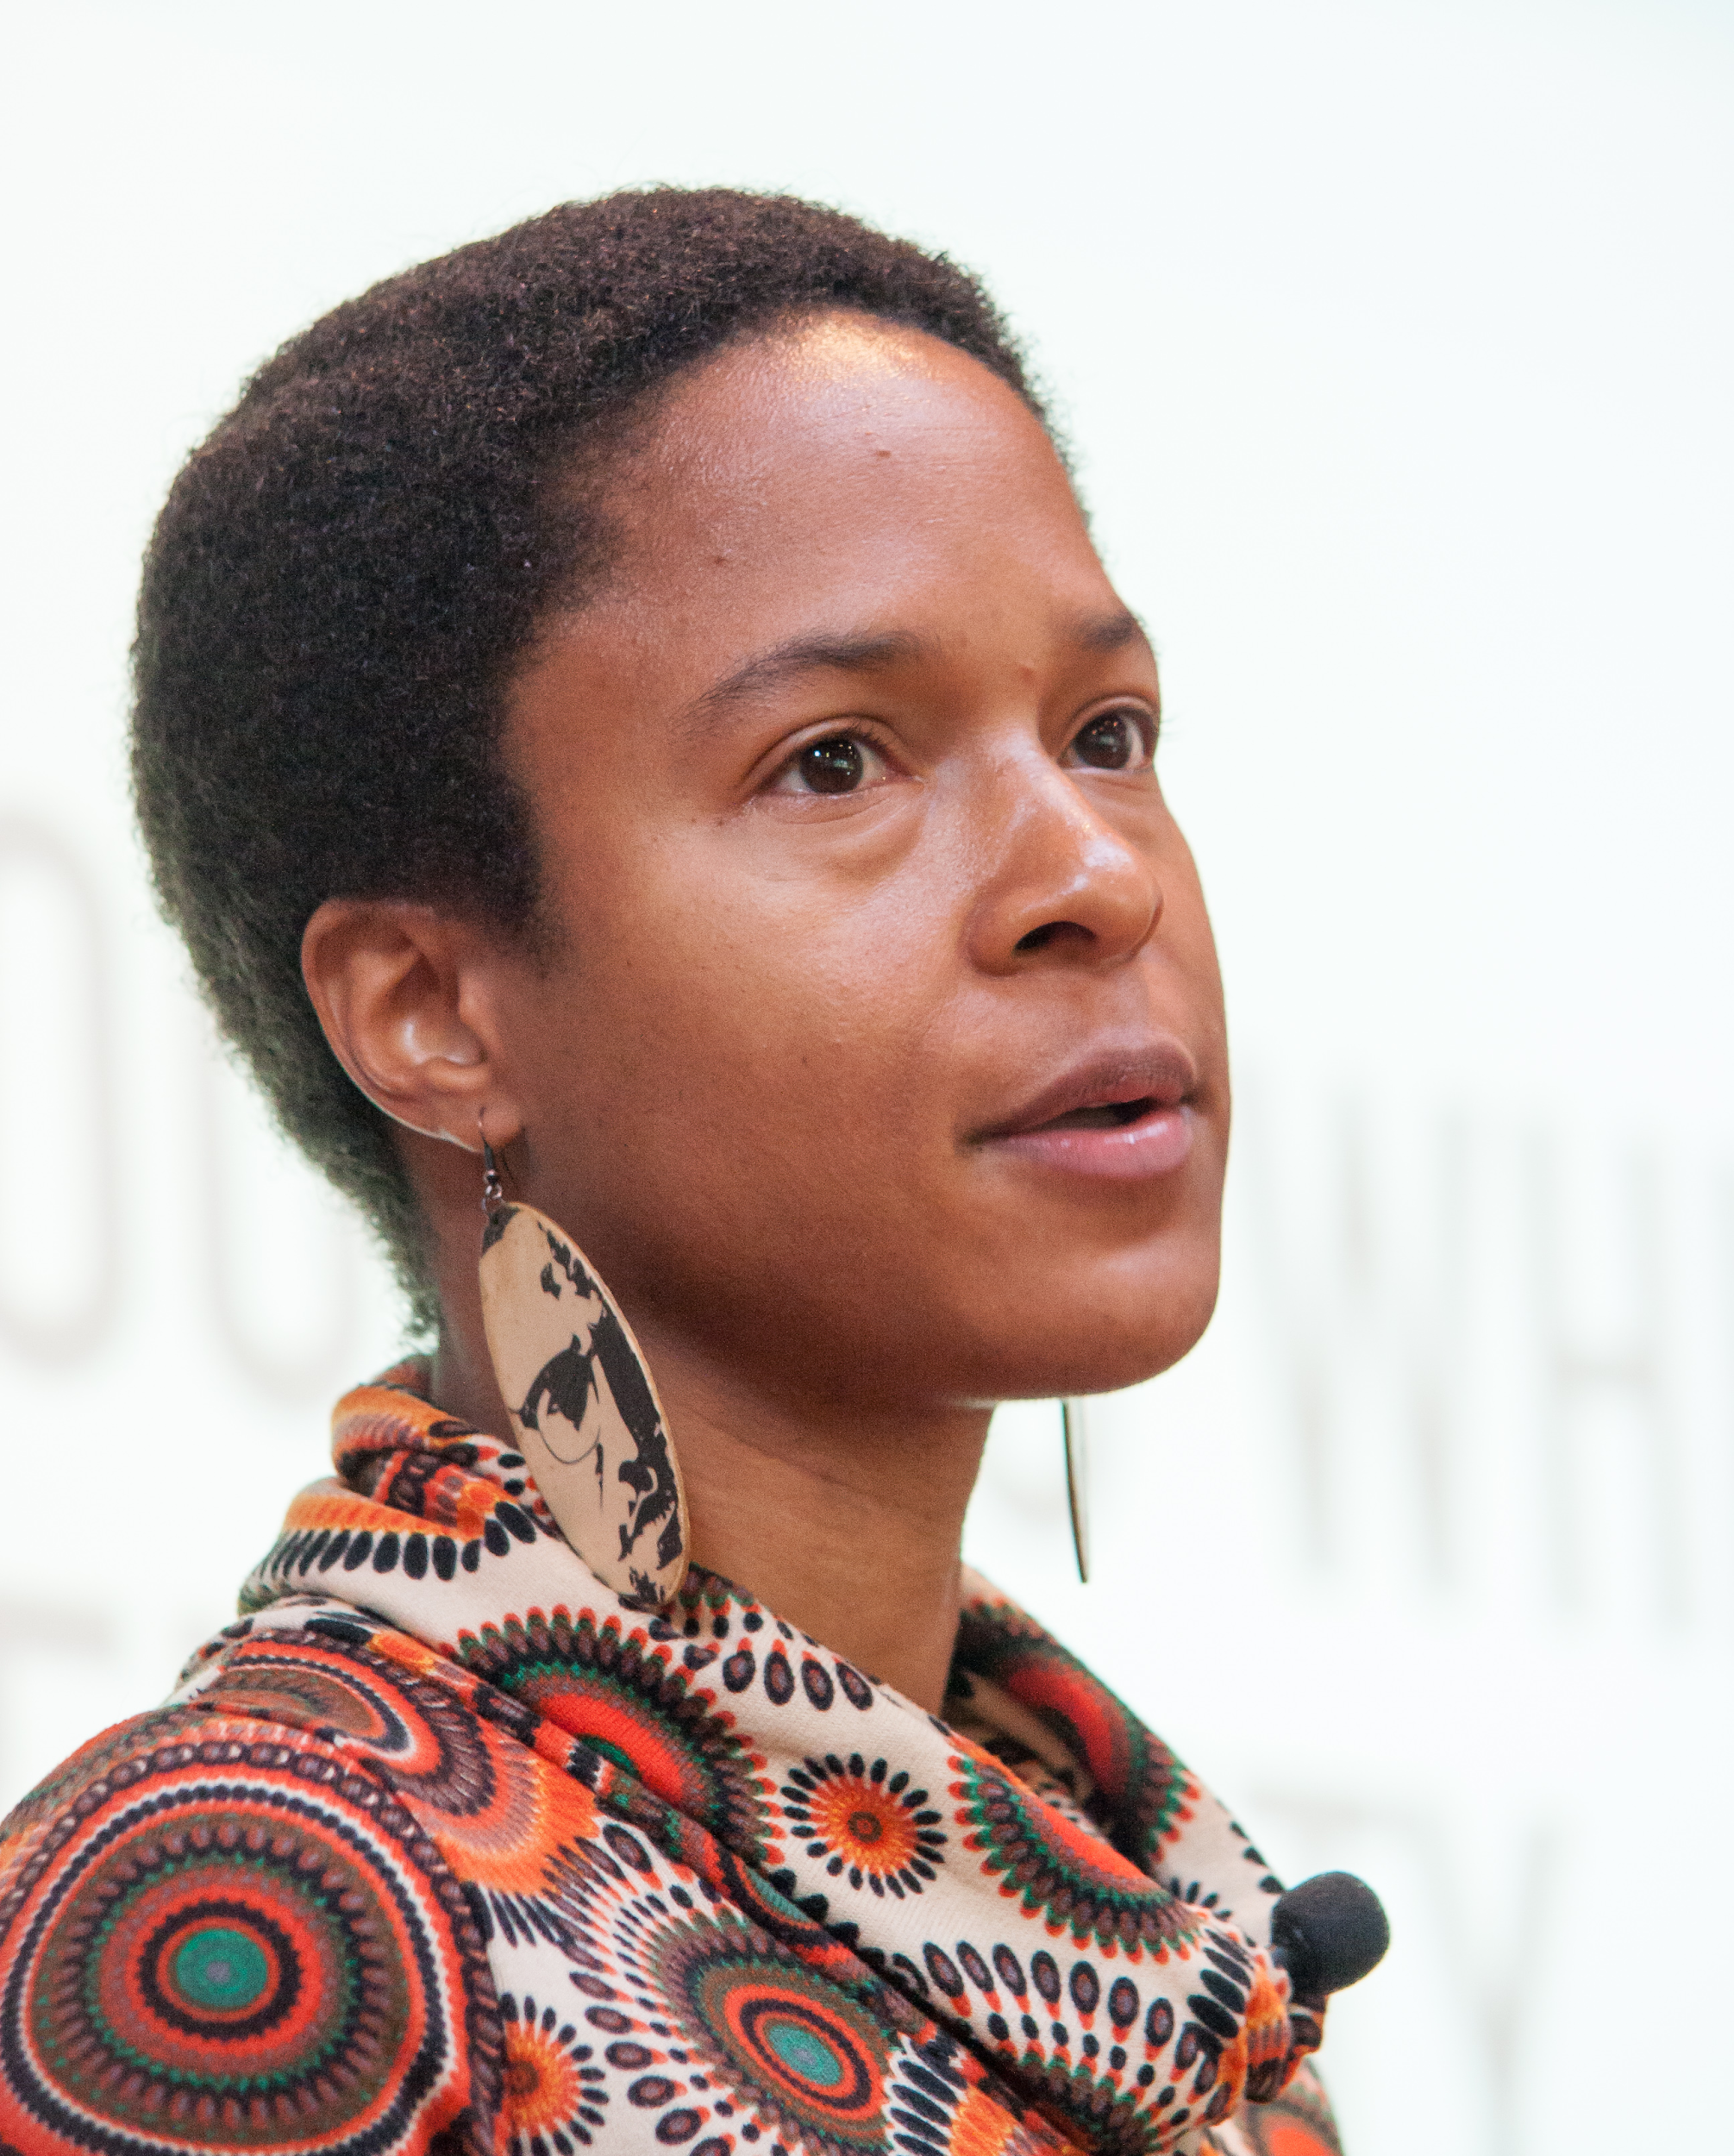
Uprooting White Fragility
Human Rights Are Animal Rights
As we listen to these talks, chart the connections between oppressive forces that Dr. Breeze Harper explicates.
Dr. Breeze Harper

Slide 8
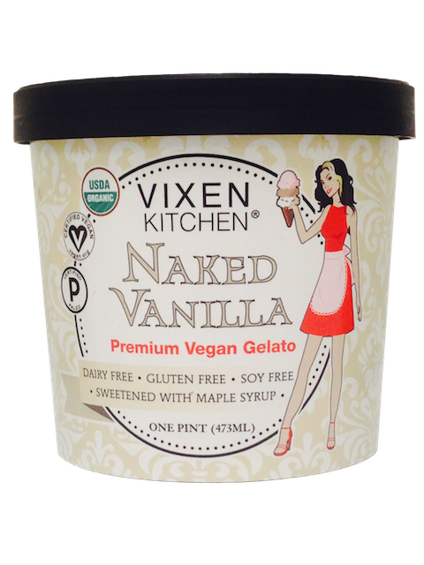

Slide 9
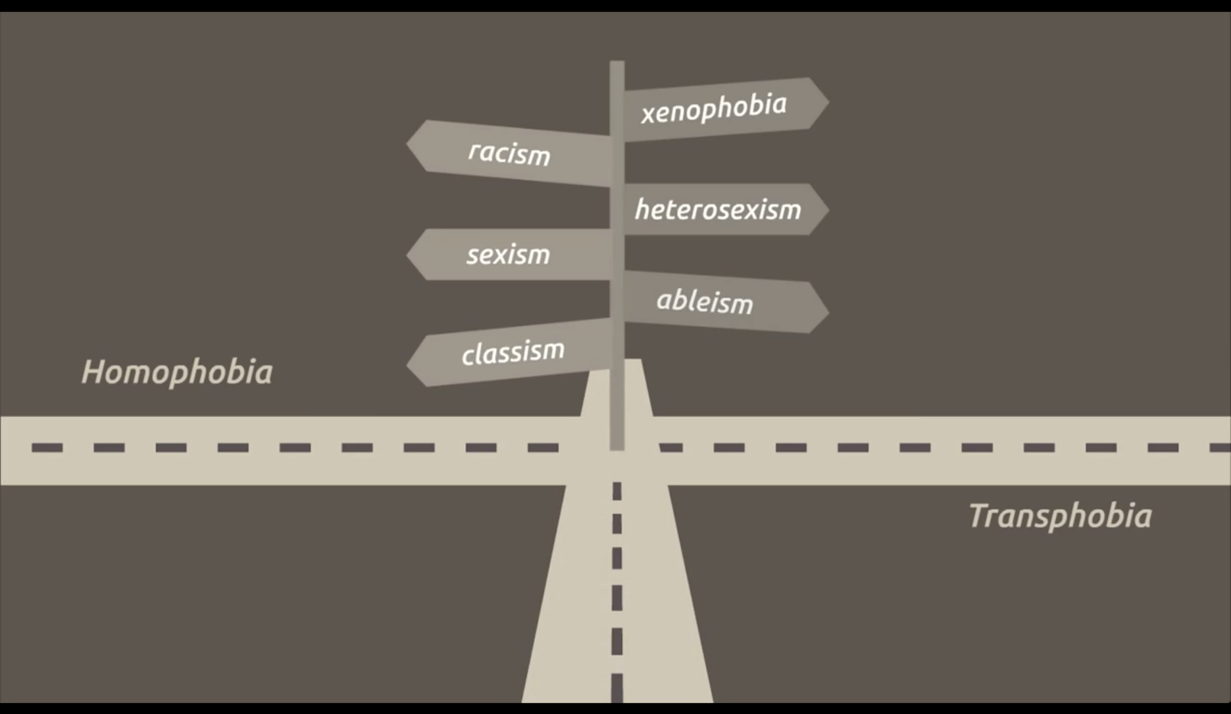
What Is “Intersectionality”?
“When it comes to social inequality, people’s lives and the organization of power in a given society are better understood as being shaped not by a single axis of social division, be it race or gender or class, but by many axes that work together and influence each other. Intersectionality as an analytic tool gives people better access to the complexity of the world and of themselves.”
—Patricia Hill Collins and Sirma Bilge, Intersectionality

Slide 10
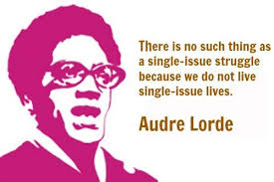
Intersectionality is about asking the question: How does each axis of oppression operate here? It means also being receptive and responsive to the answer.

Slide 11
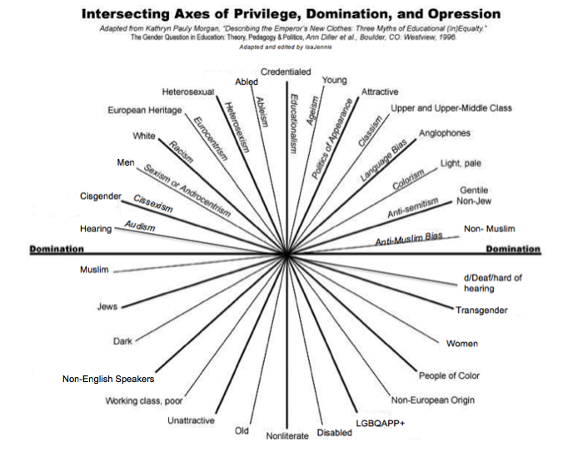

Slide 12
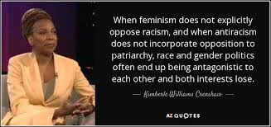
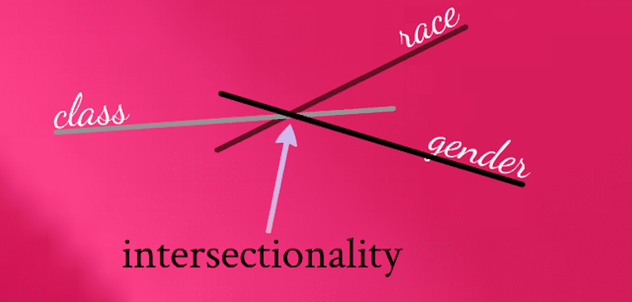

Slide 13
Our position in relation to these axes is likely to shape our worldview.

Slide 14
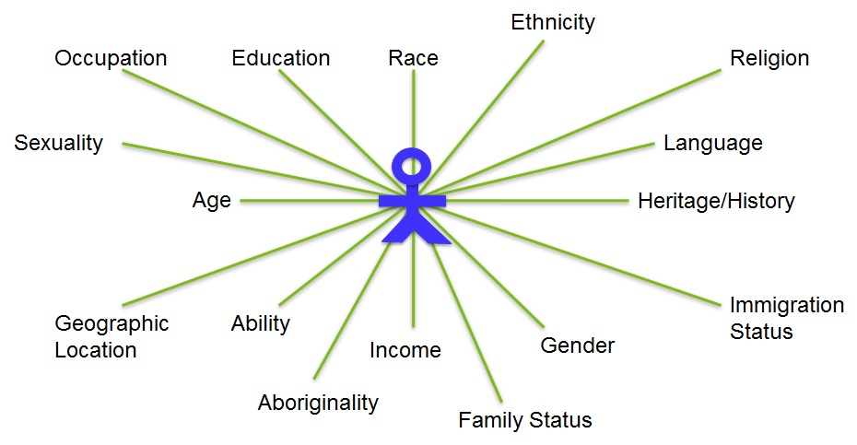
Positionality - Who You Are In Social, Historical, Political, and Ecological Context

Slide 15
Knapsack Exercise
If a statement in this list were true of you, what might you be predisposed to believe or assume?
What do you think this tool is meant to provide?

Slide 16
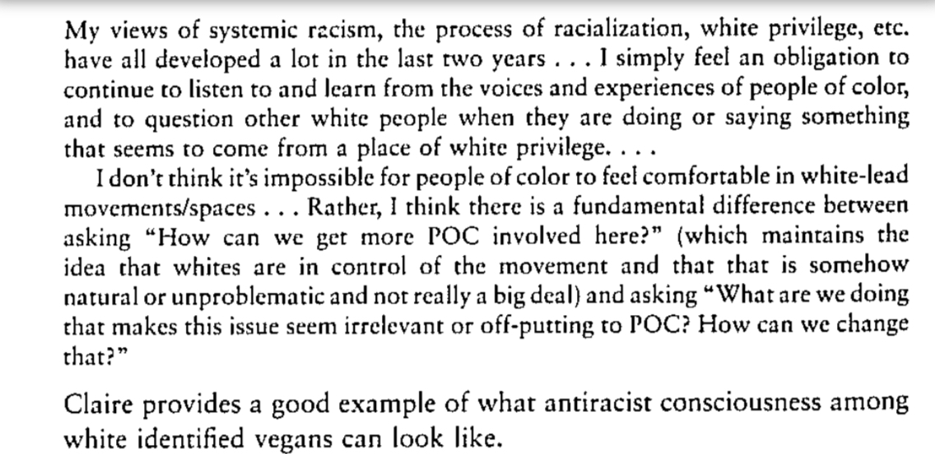
From our Breeze Harper reading
Notes:
“...there is fundamental difference between asking, ‘How can we get more people-of-color involved here?’ (which maintains the idea that whites are in control of the movement and that that is somehow natural or unproblematic…) and asking ‘What are we doing that… [is] irrelevant or off-putting to people-of-color?”
From student Iran Ortiz: Harper uses "expected whiteness" to explain the "post-racist" white mentality. This is the centering of "whiteness" and its function to ignore others and reinstate their privilege and position in society.
From student Patricia Kly: Expected whiteness is where the audience or people who are involved in something (in this case veganism) are assumed to be white. Because of this, the thing (veganism) is catered towards these people and quickly becomes exclusive against people of colour. It excludes perspectives and realities other than the white experience and can make it difficult for people of colour to be involved in the movement as they are not recognised.

Slide 17
Your Personal Reactions to the Knapsack Exercise
(Thanks to Dr. Sarah Ray for these prompts.)
Pick three statements from the knapsack exercise that did any of the following:
Surprised you or confused you (perhaps regarding why they were on the list);
Revealed something about your own identity and life story (positionality, path, past, privilege) that you don’t often think about;
Speak to or validate your own experience with environmentalist ideas.

Slide 18
Take-Away Ideas from the Knapsack Exercise
Our views are reflections of the worlds we have lived in.
...Our views can also change.
What has your own positionality led you to believe about the topic you’re engaging in the essay you’ve started?
Listing on the board: beliefs appearing in our essays

Slide 19



FIVE HOUSES
A
B
C
D
E
Slide and exercise by Dr. John Johnson

Slide 20
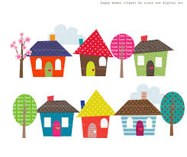
What we want in our writing:
Seeking difference in a way that is honoring and not appropriative
Identifying how power operates in centering some experiences and excluding others
What does this look like in practice?

Slide 21
What is the point of the knapsack exercise?
We all have what Gloria Anzaldúa calls “blank-spots.”
That’s why we need to keep ourselves in conversation. That’s why we need to keep learning, and seeking our perspectives different from our own.
In deepened self-reflection we can find deepened connection.
Notes:
Thanks to Dr. Sarah Ray for the quotes we see on this slide.

Slide 22
Think of a time when you recognized the limitations of your lens or your worldview. Maybe you’ll think of a time when you overlooked a harm or didn’t understand what someone else was experiencing. How did you come to understand what you didn’t at first see?
Think of a time when you helped another person to see the limitations of their lens of worldview. How did you approach the communication with this person?

Slide 23
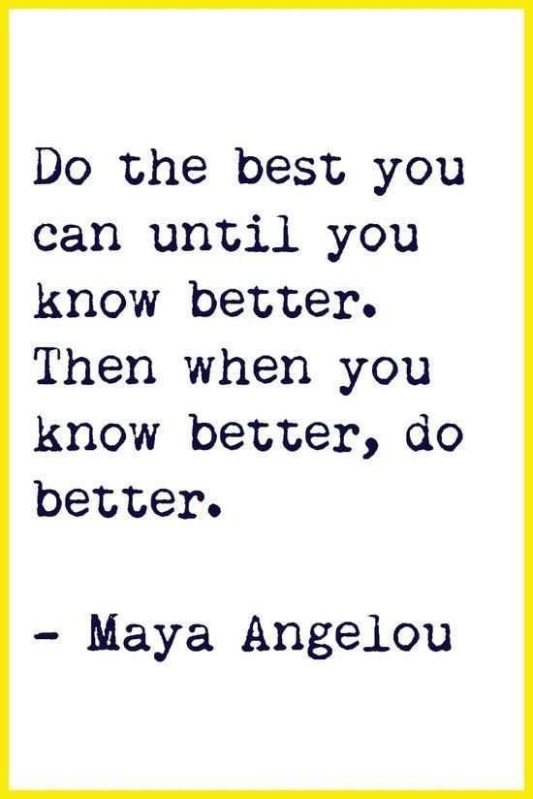
What needs to be present for one to be receptive to being ‘called out’ or ‘called in’?
Receptiveness versus defensiveness
Letting go of perfectionism
Self-acceptance, self-forgiveness
Mindfulness: ‘what is showing up for me?’
Humility: knowing I don’t have all the answers
Empathy & eagerness to listen to another without demand (a gift shared)
A learner’s orientation / growth mindset
Believing that it’s valuable and necessary to be uncomfortable
Understanding that ideas are ‘in the air’. We receive problematic ideas from our world. But we can, with effort, change how we think.
(Sounds like our classroom community agreements…)

Slide 24
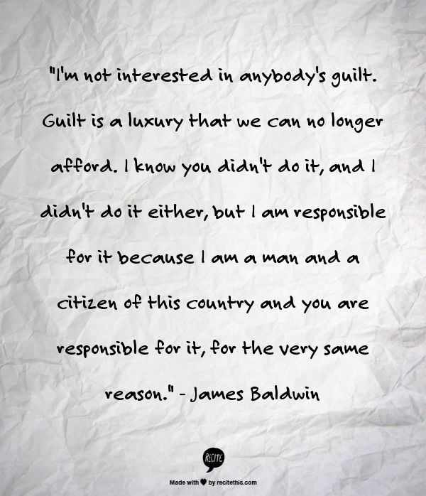
Moving past white shame: "To acknowledge one's privilege is not a moral condemnation. Rather, it is a call to action that requires collective work in order to evenly distribute access to power and to resources so that human agency can be reclaimed and claimed by all. Our intention is not to inspire guilt but to inspire action."

Slide 25
Part 2

Slide 26
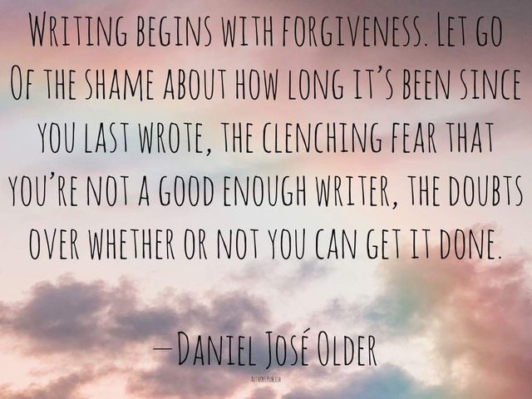

Slide 27
Checking in: our daily writing practice
What discoveries
are you making about your
processes and practices
as a writer?
Sharing in our round table

Slide 28
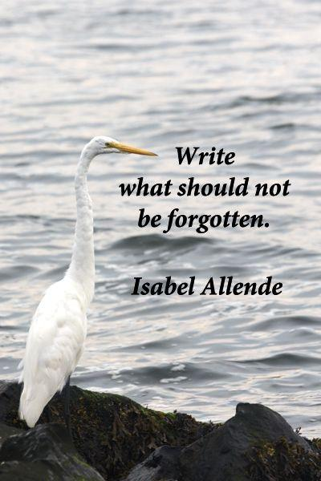
Opening writing prompt
(you’re invited to add this to the draft you brought to class today)
Reflect:
What does your essay need from you?
Who are you in your essay?
What about your background influences your approach to your essay?

Slide 29
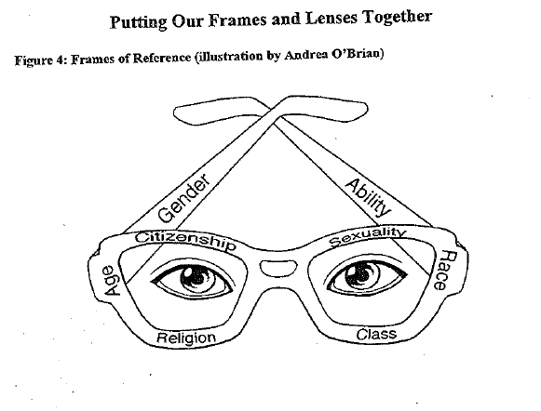
Developing a Lens for Your Lens
Image from Robin DiAngelo, What Does It Mean to Be White?

Slide 30
Eli Clare: Positionality
My body is “[a] body of white, rural, working-class value. I still feel an allegiance to this body, even as I reject the virulent racism, the unexamined destruction of forest and river” (11)

Slide 31
How Clare Acknowledges Positionality
From your reading response quiz:
Clare references the worldviews he learned as a child as specifically "white" and "Western." (For example, the words "In the white, Western worldview that I learned as a child..." start the section on page 22.)
Why is it important to explicitly name these understandings as "white" and "Western"?

Slide 32
The book Exile and Pride opens with a discussion of Clare's positionality. The chapter is titled "A Note about Gender, or Why Is This White Guy Writing about Being a Lesbian?" He writes,
Over the last decade in my continued process of reading, I've chosen to slide across some gender line. The process is most commonly understood as gender transition, but I've experience it less as one discrete transition from woman to man than as a long meandering slide. Today I live in the world as a man, even while my internal sense of gender is as a genderqueer, neither man nor woman. At the same time, I have no desire to abandon or disown my long history as a girl, a tomboy, a dyke, a woman, a butch.
In many trans and queer communities today, my particular gendered story is not all that unusual. But other those communities, the reality of a white guy have a long, prideful lesbian past can be totally disorienting. Rather than explain myself in the face of cultural confusion, anger, and/or hatred, I yearn for the day when all the rules that confine and constrain gender, that punish gender transgression--rules shaped by misogyny, transphobia, homophobia, and shaped again by white supremacy, capitalism, ableism--come crashing down. I want my gendered story to be one of many stories that defy, bend, smash the gender binary. But in the end, what I really want is for all the many gendered possibilities in the world to be, not normal, but rather profoundly ordinary and familiar.

Slide 33
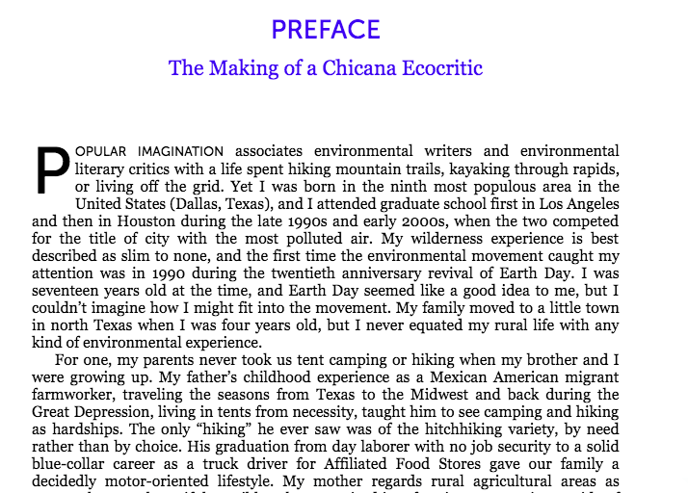
Priscilla Ybarra, Writing the Goodlife

Slide 34
POSITIONALITY
Core Concept: There is no such thing as an “objective” stance. Our understanding of the world is conditioned by the identities, contexts, experiences, and perspectives we inhabit. Self-reflexivity is important. Transparently grappling with issues of power and privilege is an important way of building your ethos in a piece of writing.

Slide 35
Review: Discussion of Positionality
As we flip through the slides we used to discuss positionality, write on a notecard two things, on the two sides of the notecard. Do include your name.
Side 1: What does positionality mean to you, as a writer?
Side 2: What would you like to learn more about?

Slide 36
Looking at the creative nonfiction essays you’ve started so far, think about...
Activist writing doesn’t mean “preachy” writing….
We can cause readers to see the world differently without saying “this is how it is” or “this is all there is” (the single story).
We can reflect on our positionality—what it means for us to be writing what we write. We can actively work on our “blankspots.”
We can make an argument without reducing the complexity of an issue.
Look at the essays you’ve written so far:
To what extent do your essays fall into the “dangers of a single story”?
To what extent do your essays demonstrate cultural humility?
To what extent do your essays acknowledge the complexity of an issue?

